Slide 1
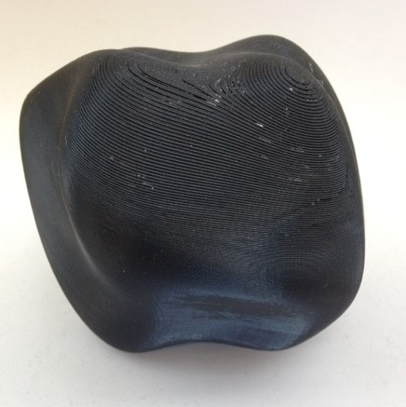
Single Anchor Sorting of Visual Appearance as an Oriented Graph
Nathan Moroney, Ingeborg Tastl and Melanie Gottwals
Print Adjacencies & 3D Lab, HP Labs, HP Inc.
Michael Ludwig^{1,2} and Gary Meyer¹
University of Minnesota¹
Google²
IS&T Color Imaging Conference, CIC26
Vancouver, BC
November 2018

Slide 2
Outline
TL;DR – perceptual similarity as a graph
Motivation and context
Ranking stimuli relative to an anchor
Two experiments
Web-based ranking of 3DP complex appearance
Laboratory ranking of solid colors
Representation and analysis
Graph in which nodes are stimuli and edges are the rank sequence
Thickness of edges is proportional to rank for all observers
Rank aggregation using Schulze voting method
Evaluating models
Future directions

Slide 3
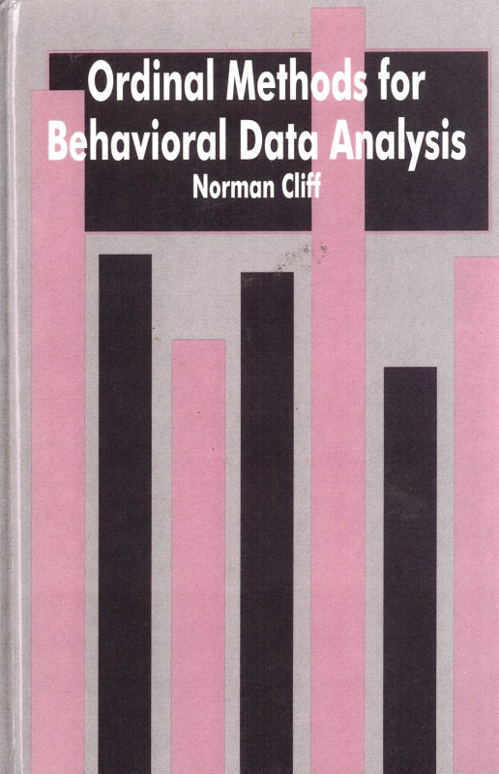
Motivation and Context
Ordinal Methods for Behavioral Data Analysis was an interesting read
Even efficient methods of paired-comparison can be time consuming and volunteers may complain
Interested in rank order methods and metrics
Perhaps most familiar example in the field, Farnsworth-Munsell 100 hue test
Engledrum describes ordinal methods and averaging ranks, for a single -ness
Progress made during Michael’s summer internship and subsequent collaboration with Gary Meyer:
Ludwig, Michael, et al. "Perceptual Appearance Uniformity in 3D Printing." Electronic Imaging 2018.8 (2018): 1-12.
Recent results in web-scale data collection for perceptual metrics:
Zhang, Richard et al. "The Unreasonable Effectiveness of Deep Features as a Perceptual Metric", CVPR (2018).

Slide 4
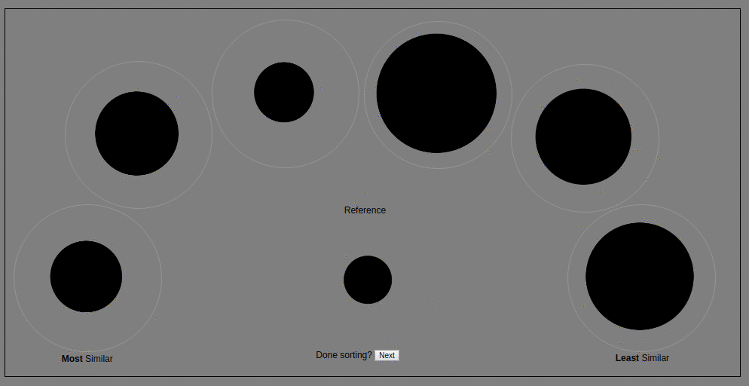
Anchored Ranking
Rank perceptual similarity relative to a single reference
Simple example varying only the diameter
Drag-and-drop as interface
Center is reference
Left is most similar
Right is least similar
Arc layout is used to allow larger stimuli and roughly equal distance for comparisons to reference stimuli

Slide 5
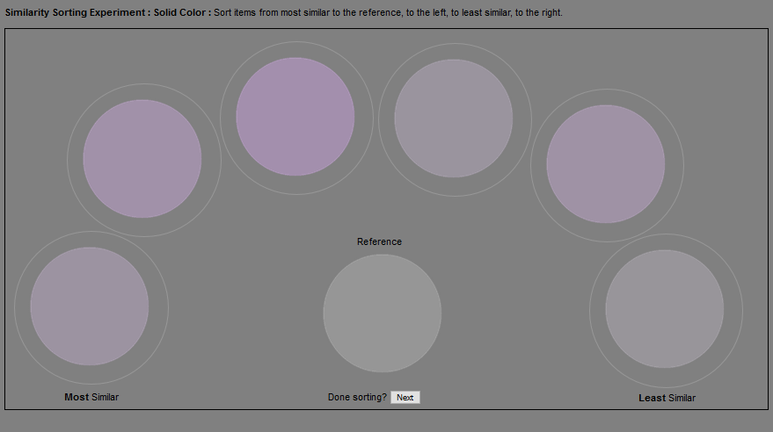
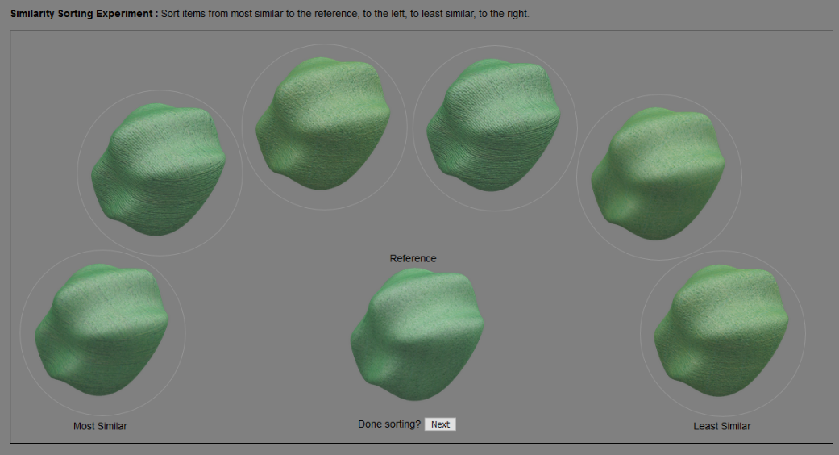
Two Visual Experiments
In all cases, one reference and six stimuli to sort
Solid colors
Generated with a target color difference between neighbors
Conducted in laboratory with calibrated display and viewing conditions
Simulated complex appearance of 3D printed blob
Generate varying two rendering parameters per sequence
Conducted online with unknown displays and viewing conditions
Both experiments started with two test sequences
A Deuteronomic color sampling
A sequence of abstract shapes

Slide 6

Graphing Similarity
Stimuli
Networks: An Introduction was also an interesting read
Perceived similarity as a directed graph
Nodes : stimuli
Edges : sort sequence neighbors (or rank order)
In the proceedings referred to as a sort-sequence graph
For simplicity will show as undirected graph after this slide
Reference
A
B
Sorted Stimuli
Reference
B
A
Lots of metrics, tools and
concepts in graph theory
and network analysis to possibly
leverage for perception
More similar
to reference
Less similar
to reference
Rank 1
Rank 2

Slide 7
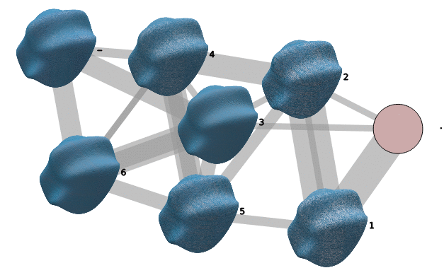
Oriented Graphs
Establishing a convention for “reading” the graphs
Algorithms for graph layout is its own research area
D3.js force-directed layout for initial layout
Manually orient increasing dissimilarity from left to right
Similar to the number line in mathematics and matches the experimental task instructions
Note “oriented” is not an established term in the terminology of graph theory
Additional conventions
Dash or – as label for reference
Period or . with empty node for “end of graph”
Increasing dissimilarity relative to reference

Slide 8
Weighted Graph
Accumulating weights
Consider using when the dissimilarity matrix just looks like a table of numbers
Thickness is proportional to number of times a node rank order occurs
Observer
Reference
Randomly ordered stimuli
Sorted stimuli
1
2
3
4
For each observer, connect corresponding neighboring ranks.
Convert number edges to thickness. Above pattern fills only an example set of stimuli.

Slide 9
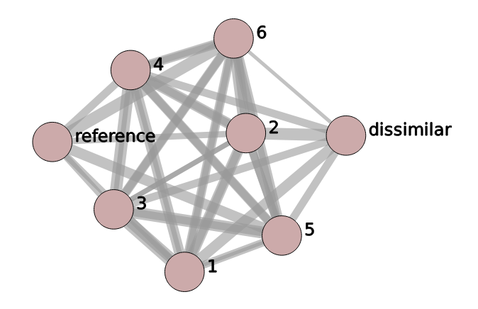
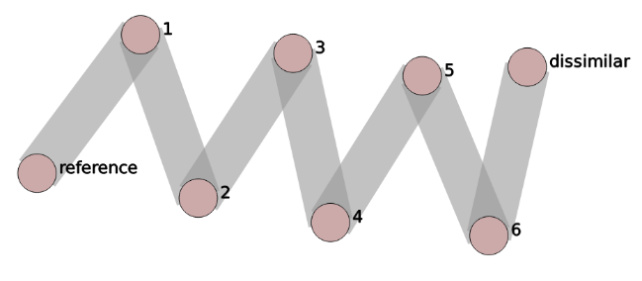
Computational Graphs
Graphs that can be directly simulated and used for comparison purposes
Two examples shown below, other processes and models possible.
But a useful example of one pair of generative endpoints.
Uniform random sorting
Perfect order sorting

Slide 10
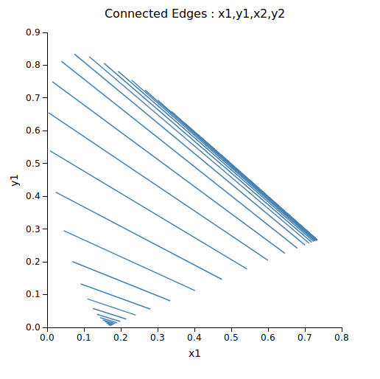
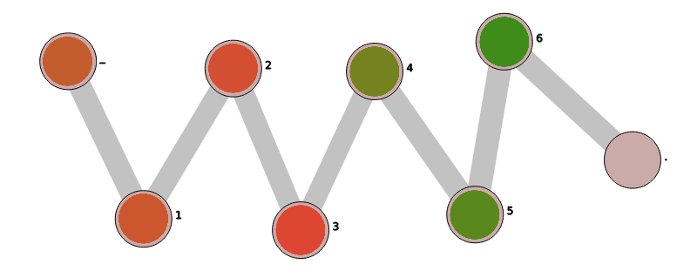
Test Sequence One: Deuteranopic Confusion Colors
Smith-Pokorny
Copunctal Points
Ramp of equal luminance solid colors from a reddish to a greenish color
70% of 150+ participants provided a sort in perfect agreement based on ΔE*_{ab} assuming sRGB as display, shown at bottom right
23% of participants had only within-color term disagreements (i.e. only oranges out of order or only greens
7% of participants have cross-color term disagreement (i.e. mixing oranges & greens)
The above 7% can be deuteranopic or ‘adversarial’ (I’ve estimated ~4% adversarial rates for past experiments)
12
81
56
19
71
6
Larger numbers above are ΔE*_{ab} w.r.t. the reference.

Slide 11
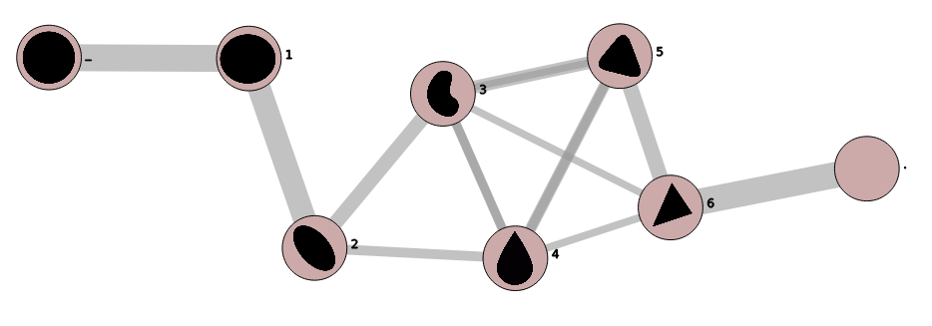
Test Sequence Two: Simple Shape Sequence
Ramp of solid black shapes from circular to triangular
This test (and the previous) are useful for assessing
instructional clarity and/or identifying adversarial participants

Slide 12
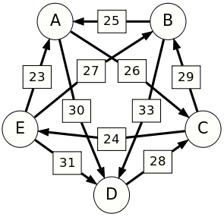
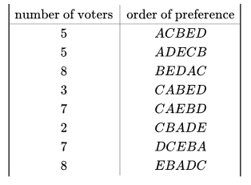
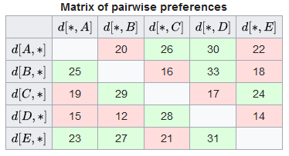
Rank Aggregation
Directed preference graph
Schulze voting method or widest path
45 voters provide rank
preferences for 5 candidates
Variant of Floyd–Warshall algorithm
Aggregated rank or
widest path is shown
as red sequence
Graphics on this slide are from
https://en.wikipedia.org/wiki/Schulze_method

Slide 13
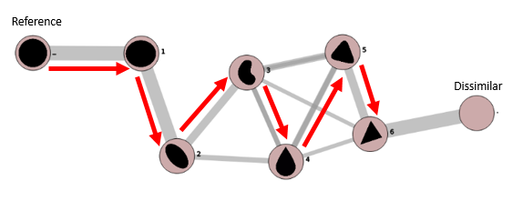
Test Sequence Two: Simple Shapes Widest Path
Circle, ellipse, bean, tear drop, rounded triangle and finally triangle
Variations here are likely due to multiple
cognitive sorting criteria, and not approaching
perceptibility thresholds
The inverse ordering of this path (the “wrongest path”) is
of interest as a possible method for outlier detection.

Slide 14
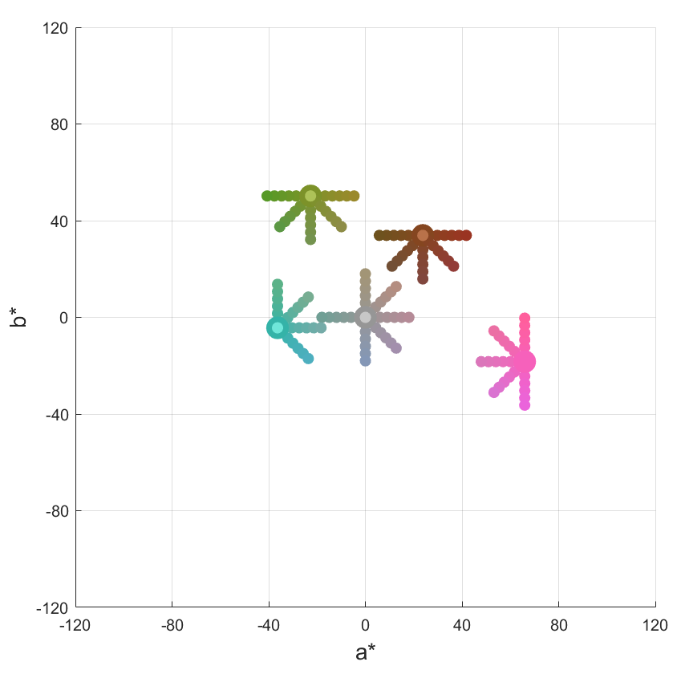
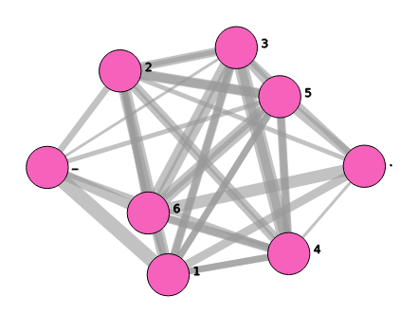
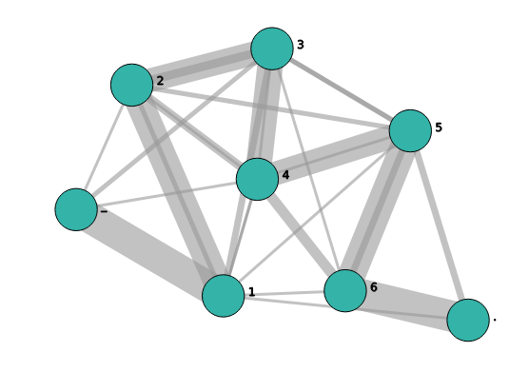
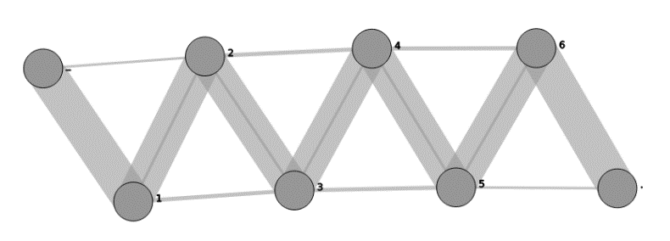
Solid Color Sorting
Sorting is easy enough, repetitions are feasible
Five nominal centroids : olive, brown, pink, teal and gray
25 different directions (in sRGB gamut)
Four ΔE*_{ab} step sizes : 3, 2, and 1
Use sRGB display in dark surround, four observers
Reference is centroid
Rank sequence is relative to stimulus set that is monotonic with color difference
1 ΔE*_{ab} : all grays, all trials
1 ΔE*_{ab} : all teals, all trials
1 ΔE*_{ab} : all pinks, all trials

Slide 15
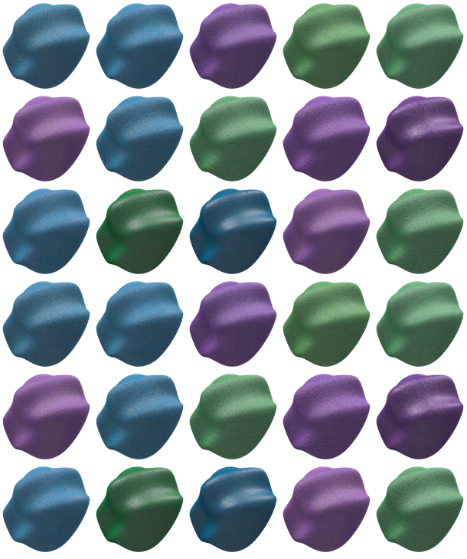
Sorting Complex Appearance
Add subtitle
HP MultiJetFusion or MJF 3D printed tiles were scanned using an X-Rite TAC 7
Resulting AxF^{tm} or Appearance Exchange Format data post-processed to magnify or diminish one or more rendering parameters
Qualitatively the diffuse color, gloss, roughness and graininess
Generate 30 sequences that have bivariate or two parameter variations in the rendering
Randomly select 6 sequences for each observer as an all volunteer web-based experiment
Blob object via the X-Rite PantoraTM software with acknowledgements to Prof. Roland W. Fleming’s design

Slide 16
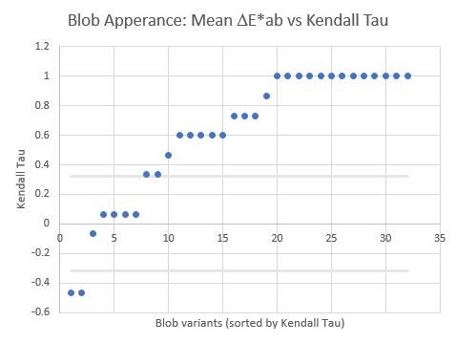
Evaluating Models
How good is simply using ΔE*_{ab}?
Use variant a of Kendall’s Tau or Τ_{a} to compare aggregated observer ranks versus the rank order as predicted by average pixel DE*ab
Simple baseline model for future comparisons
Sort the sequences by Τ_{a} and plot the resulting ordered trails
The gray bars are the plus/minus 1 standard deviation for a “random ranker”
Roughly 2/3rds have Τ_{a} value of > 0.6

Slide 17
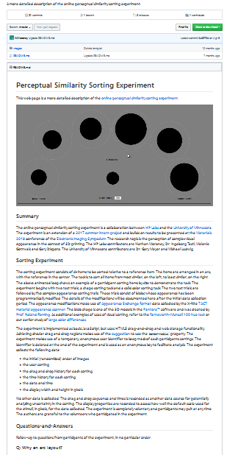
Future Directions
Obligatory plug for a related web site
Graph-based similarity analysis; kernels and classification
Using the rank data directly, in fact this is something Michael has done
Ludwig, Michael, et al. "An appearance uniformity metric for 3D printing." Proceedings of the 15th ACM Symposium on Applied Perception. ACM, 2018.
A focused investigation of color differences at the extremes of large gamut displays
For JND situations, implement a “logistic” ranker for comparison purposes
Revisit our large color difference experimental sorting data from CIC22
All data is accessible on public github page
https://github.com/NMoroney/SimilaritySorting

Slide 18
Summary
Now would be a good time to think of a question or two
Sorting stimuli with respect to a single anchor can be represented as an oriented weighted directed graph
Rank aggregation can be performed using the Schulze voting method or the widest-path graph algorithm
Model ranks can be compared to aggregated ranks using Kendall’s Tau a or T_{a}
Graph visualizations can be used to supplement dissimilarity matrices and tabular data
Ranking can also be simulated, i.e. random or perfect
ΔE*_{ab} of 1 ranges from nearly perfect sorting for grays to nearly random sorting for pinks
Average pixel ΔE*_{ab} provides a baseline prediction of MJF 3D print appearance with 2/3^{rds} T_{a} >= 0.6
Thanks!

